Slide 1

Microsoft 365 platform community call
aka.ms/m365pnp
Your host in this call: Brian T. Jackett
June 14, 2022

Slide 2
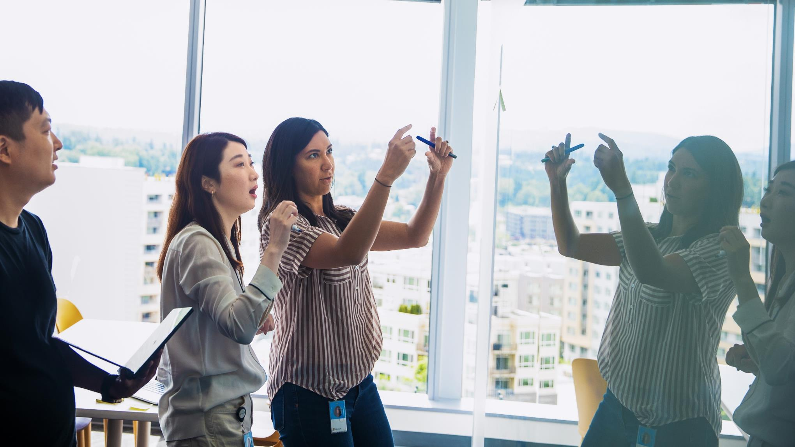
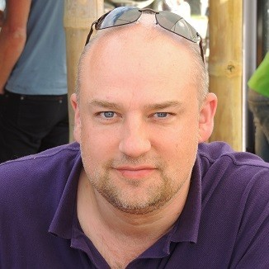
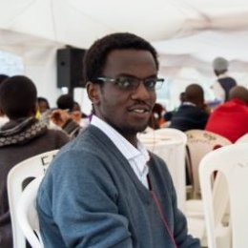

Agenda
Latest updates and news on the Microsoft 365 platform
Monthly summary on community contributors on the community channels
Group picture time with Together Mode!
Demos
Greg Taylor - Latest on deprecating basic auth for Exchange
Andrew Omondi - Microsoft Graph .Net SDK v5
Sébastien Levert - Introduction to Microsoft Graph Postman collection

Slide 3
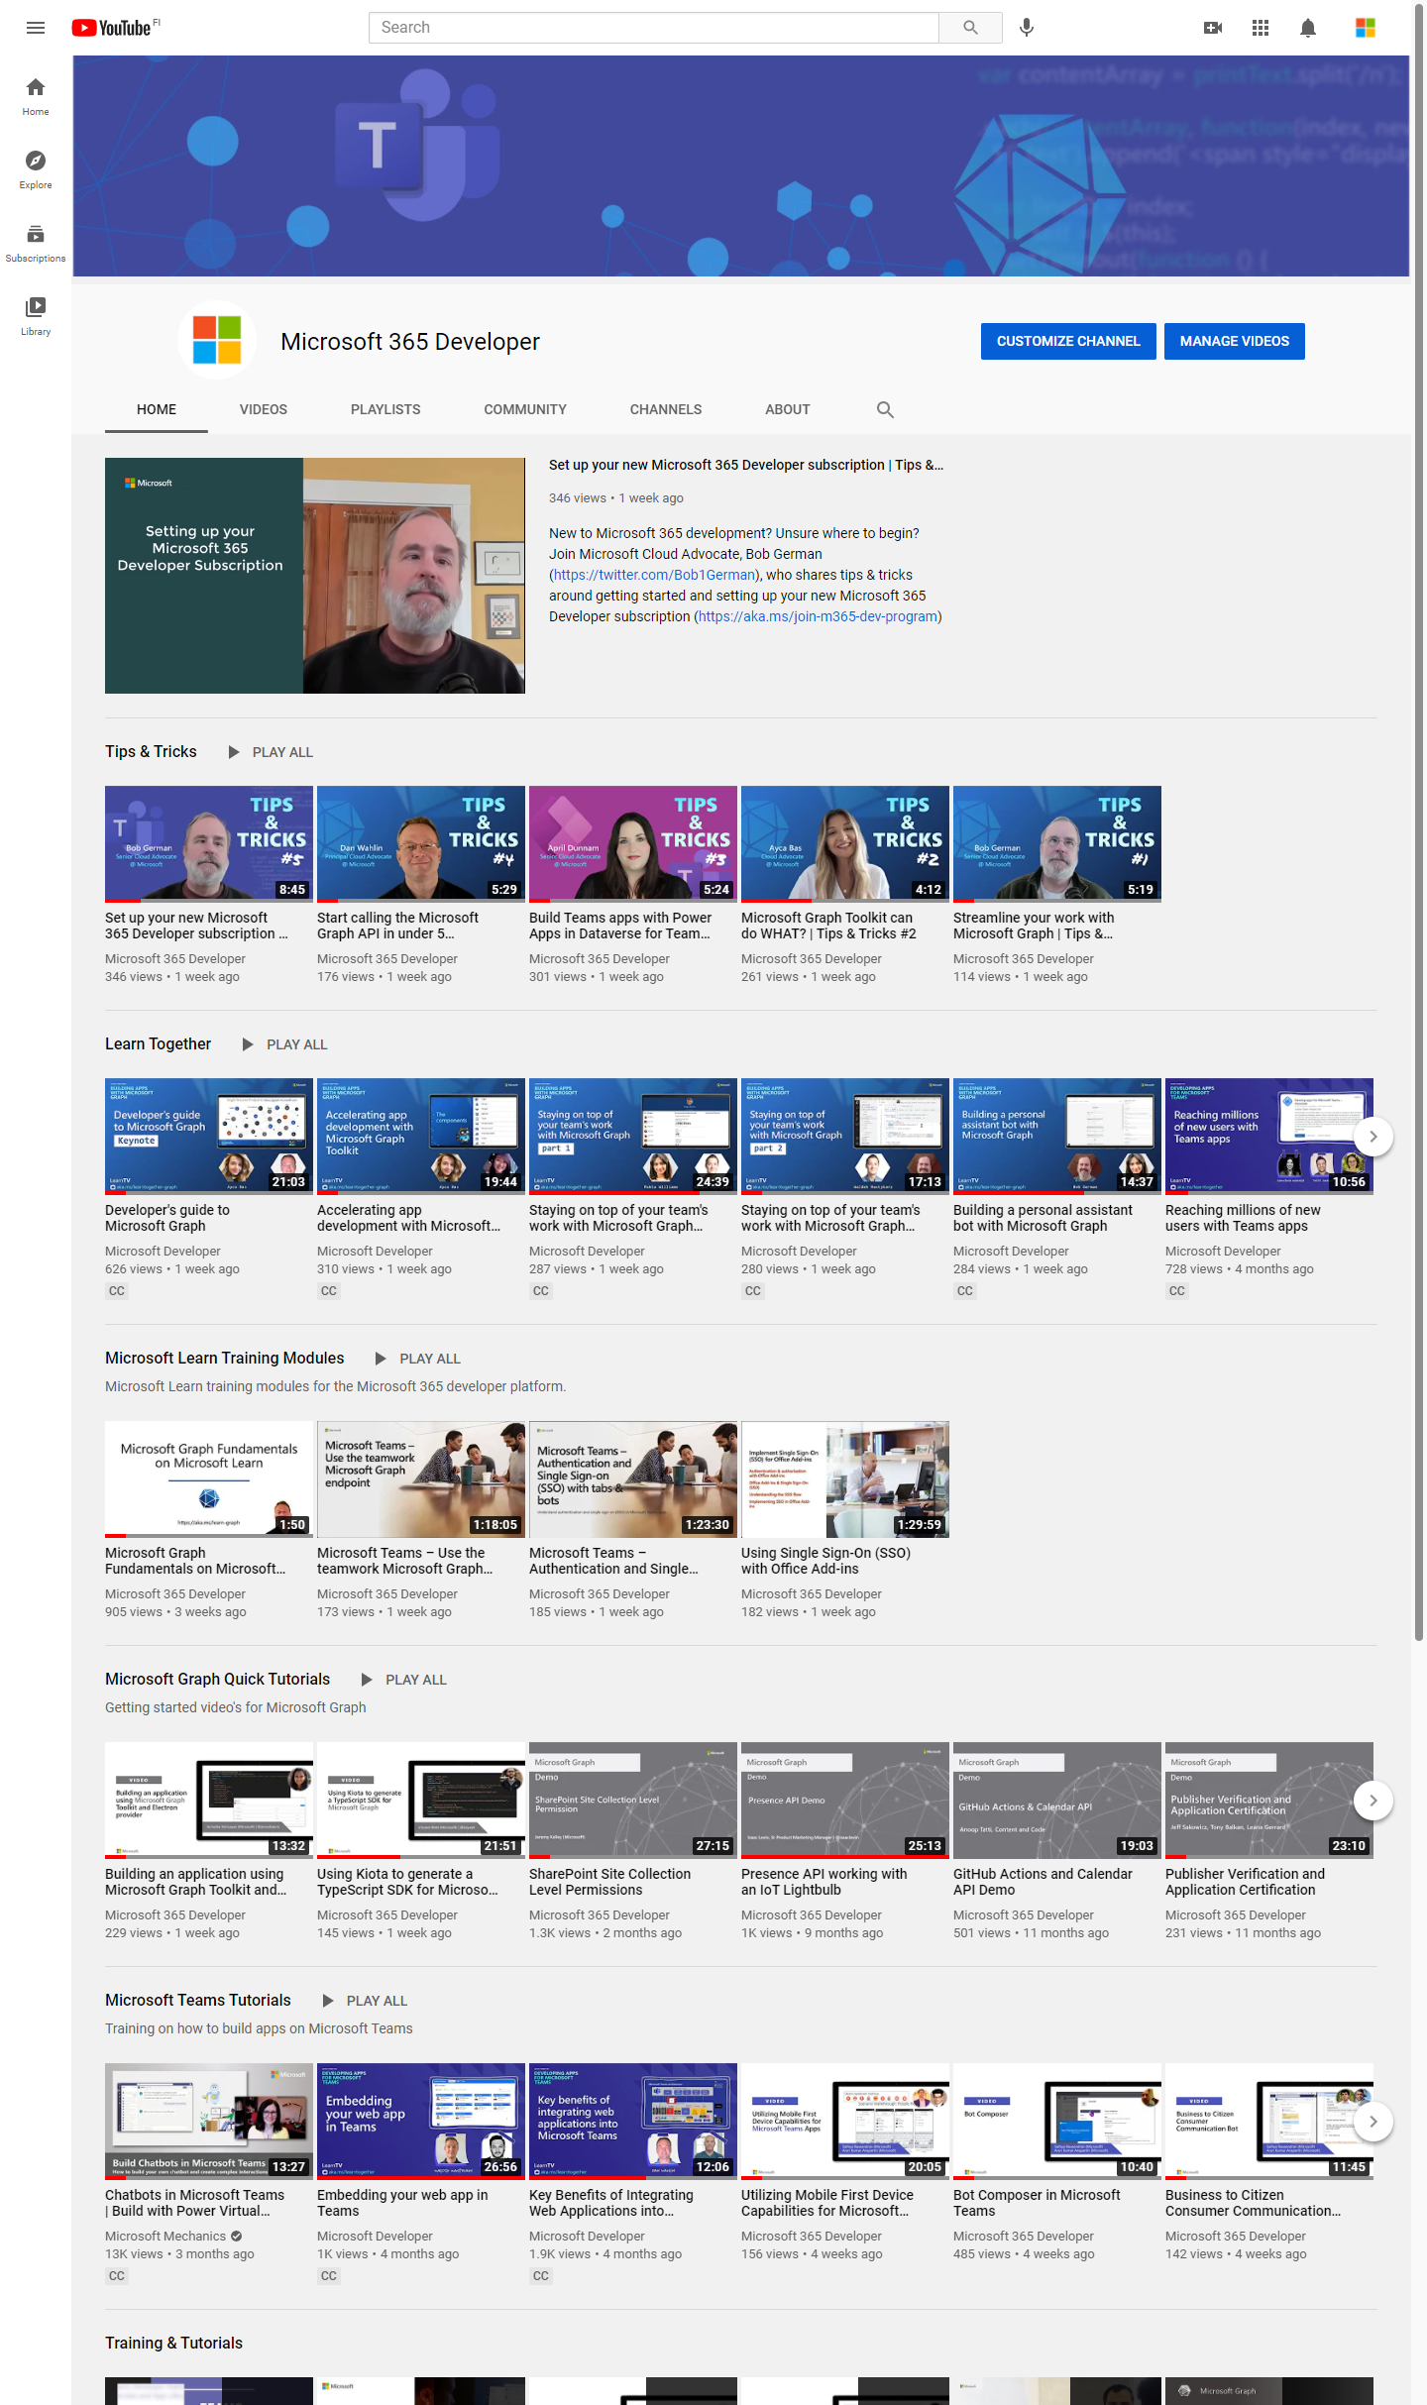
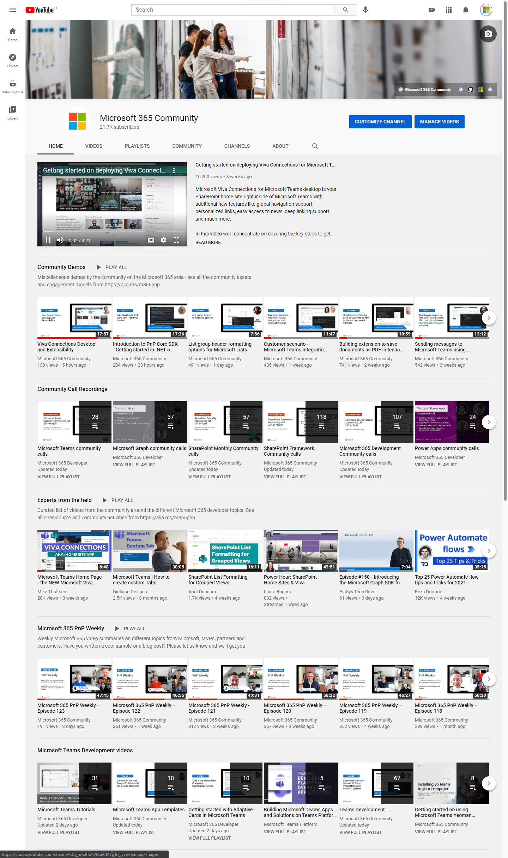
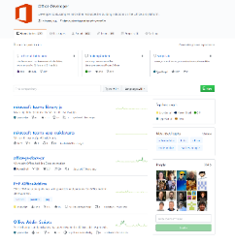
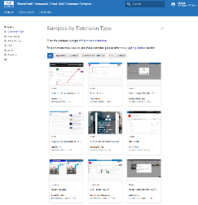
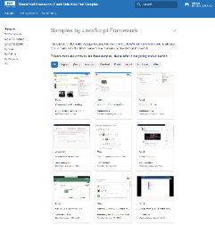
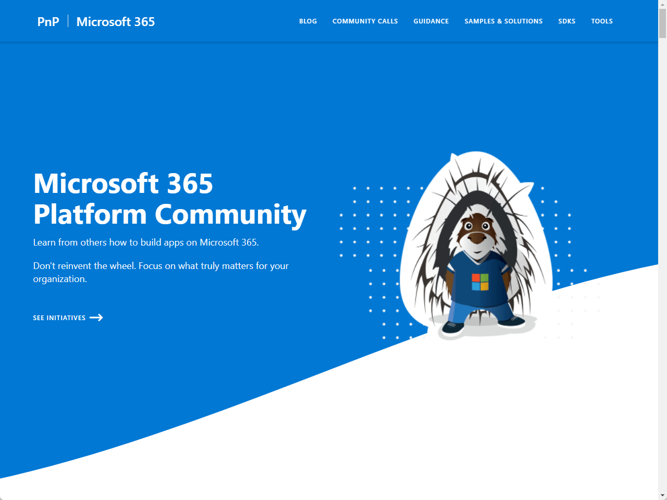
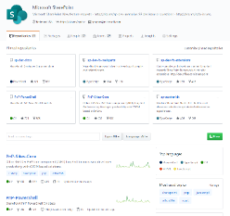
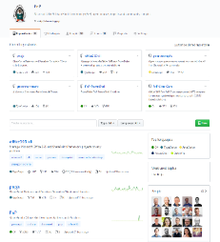
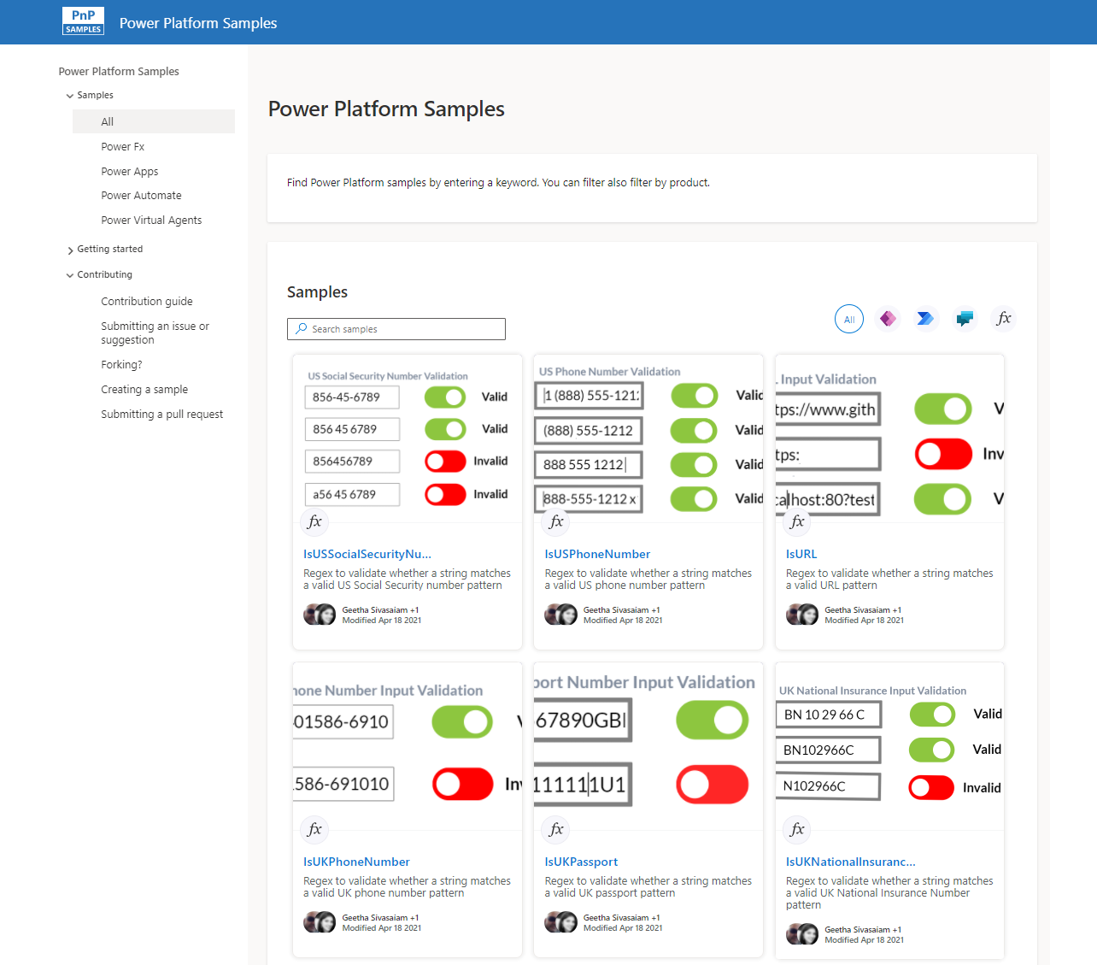
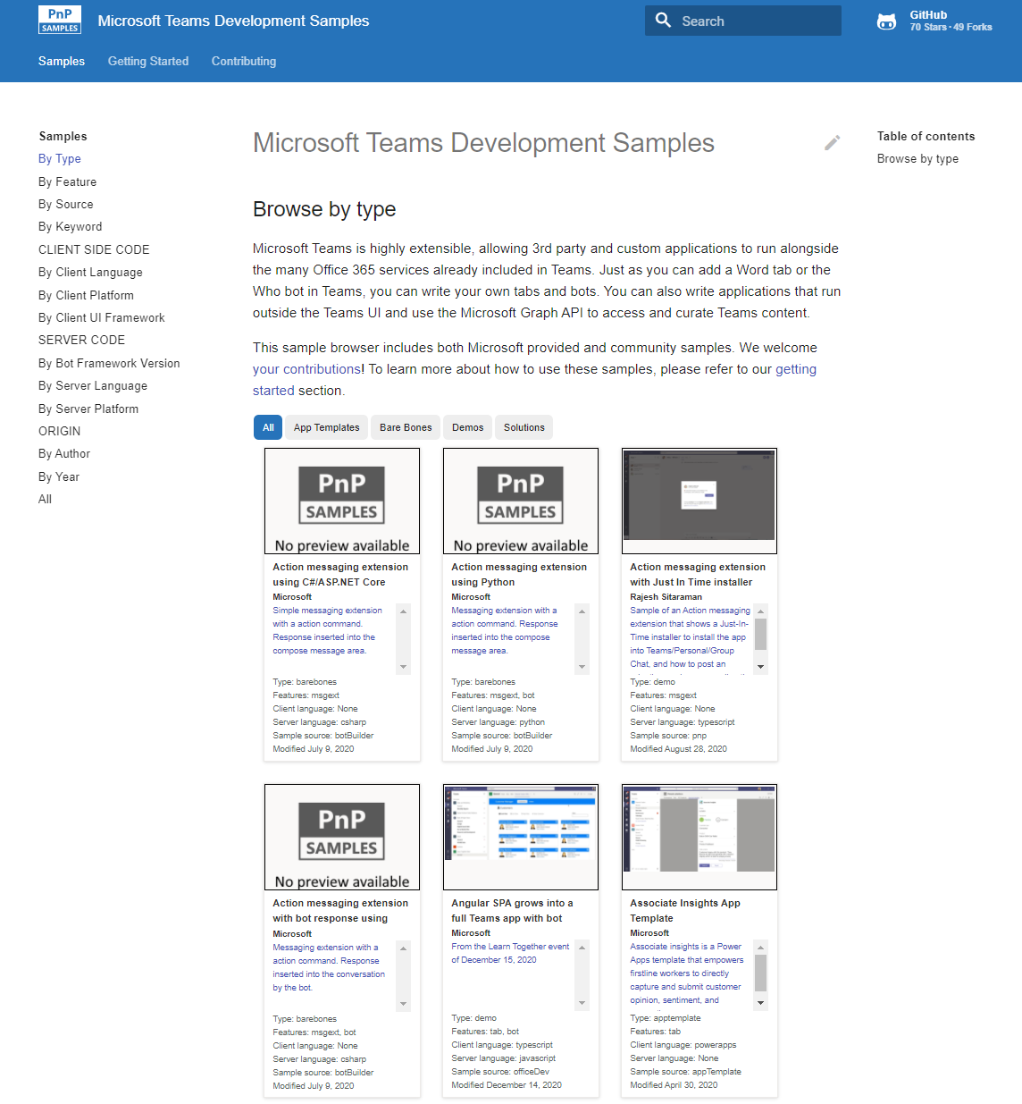
Microsoft 365 developer videos
Microsoft 365 community videos
Open-source
Sample galleries
Open-source initiatives and samples
aka.ms/m365devyoutube
aka.ms/m365/videos
github.com/pnp
github.com/officedev
github.com/sharepoint
github.com/microsoftgraph
aka.ms/m365/samples
aka.ms/teams-samples
aka.ms/spfx-webparts
aka.ms/powerplatform-samples
aka.ms/spfx-extensions
aka.ms/list-formatting
aka.ms/m365/community
@Microsoft365Dev | @m365pnp

Slide 4
Microsoft 365 developer community calls
Microsoft 365 platform (weekly) https://aka.ms/m365-dev-call
(Notice. This call is on a summer break between July 1st and 31st of August 2022)
Adaptive Cards https://aka.ms/adaptivecardscommunitycall
Microsoft identity platform https://aka.ms/IDDevCommunityCalendar
Office Add-ins https://aka.ms/officeaddinscommunitycall
Power Platform https://aka.ms/PowerAppsMonthlyCall
Microsoft 365 and Power Platform community (bi-weekly) https://aka.ms/m365-dev-sig
Viva Connections & SharePoint Framework (bi-weekly) https://aka.ms/spfx-call
Download recurrent invites from
https://aka.ms/m365/calls
Notes:
m365-dev-sig

Slide 5

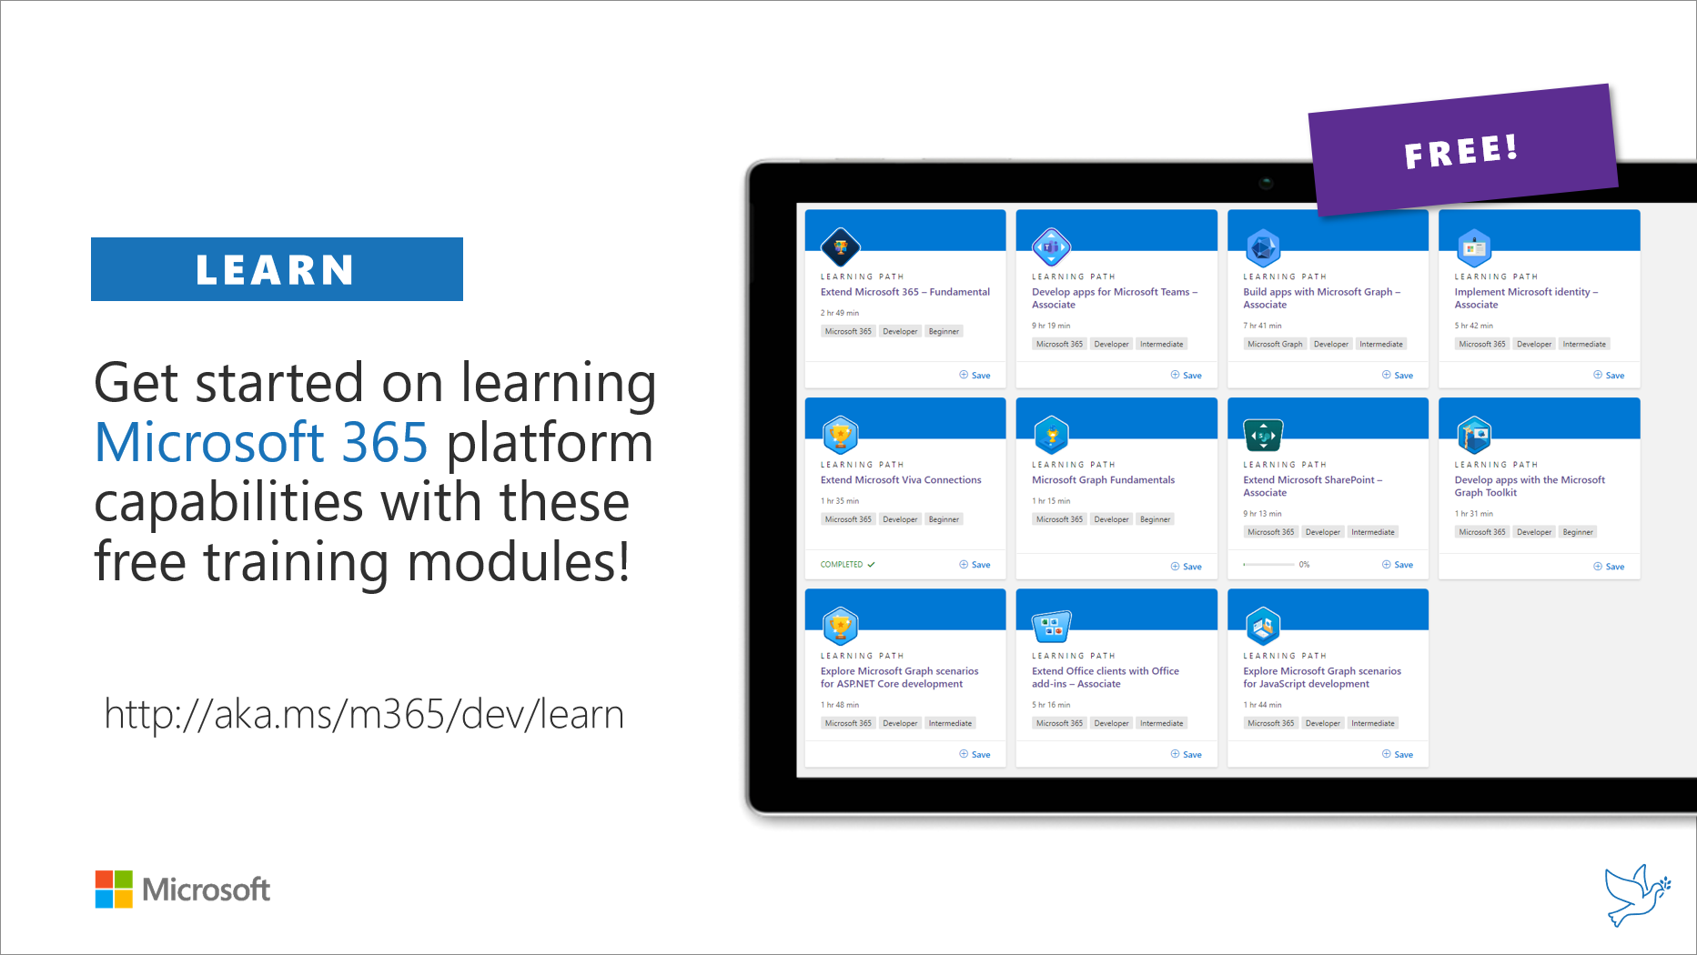
Getting started assets for Microsoft 365 dev
aka.ms/m365/devprogram
aka.ms/m365/dev/learn

Slide 6

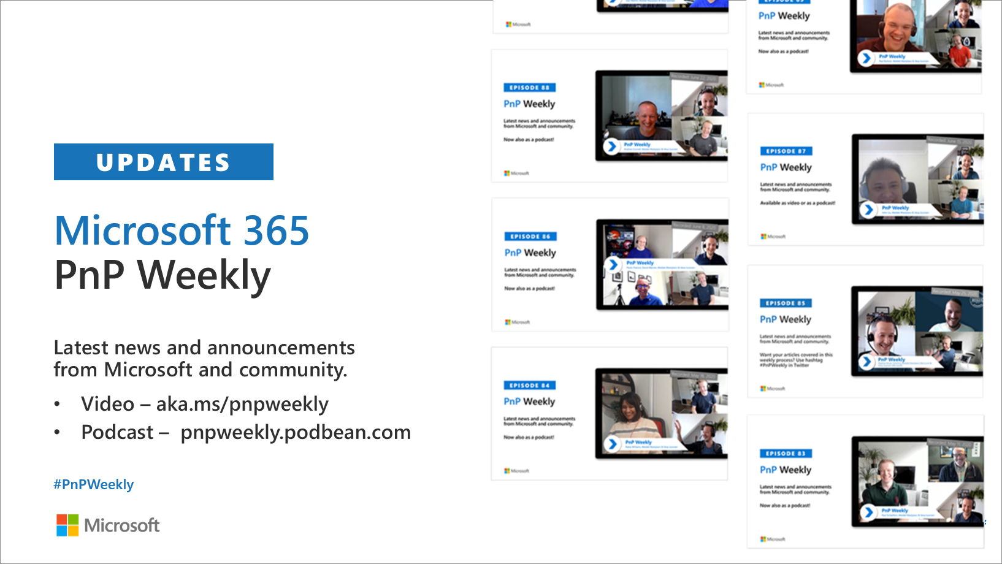
Microsoft 365 Developer podcasts
m365devpodcast.com
Video – aka.ms/pnpweekly
Podcast – pnpweekly.podbean.com

Slide 7

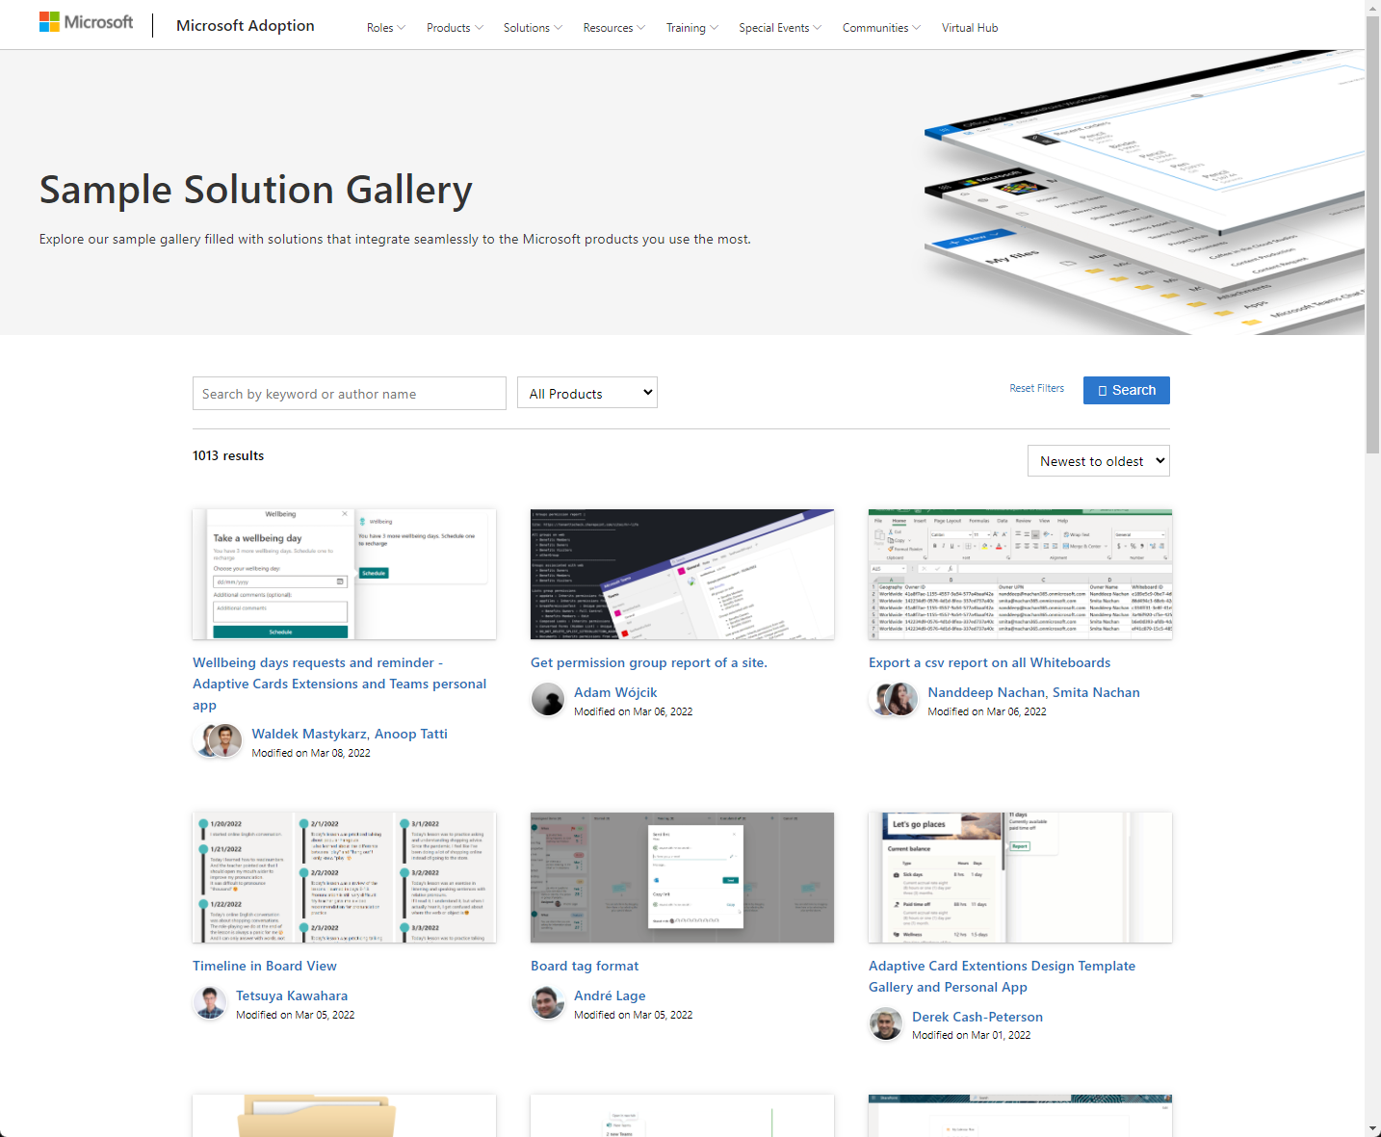
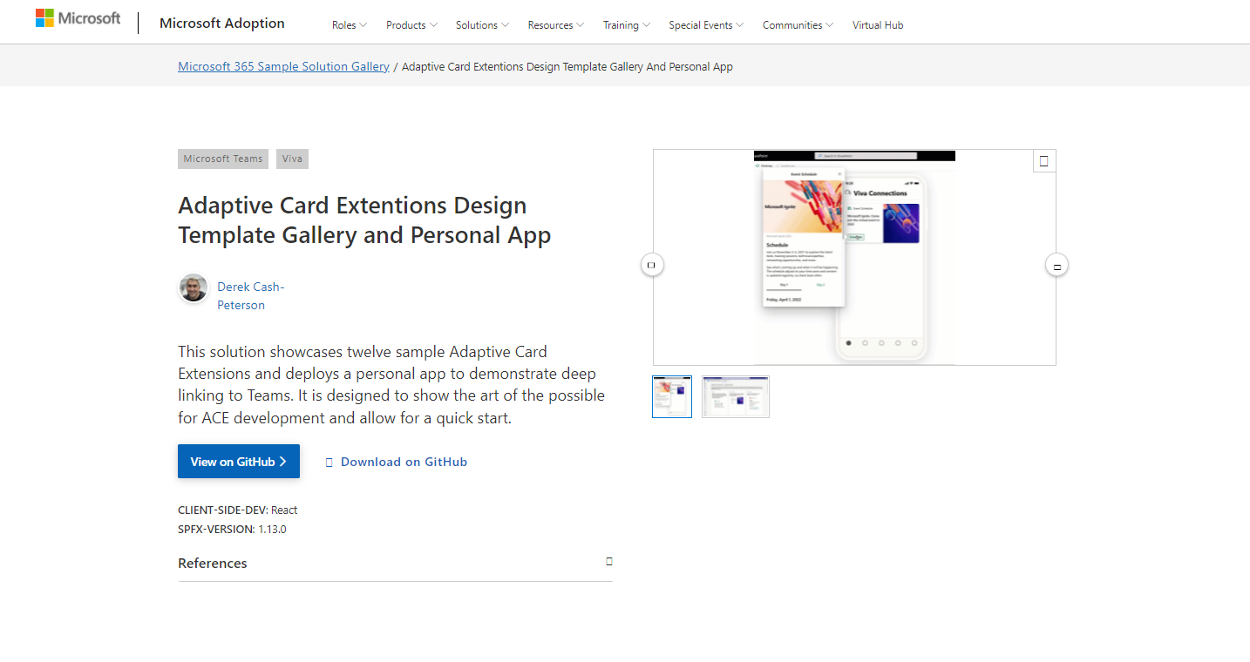
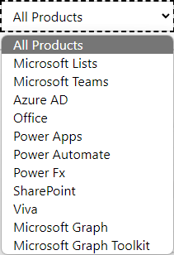

SAMPLES
New Microsoft 365 sample gallery with more than 500 samples from Microsoft and community
1090
aka.ms/m365/samples

Slide 8

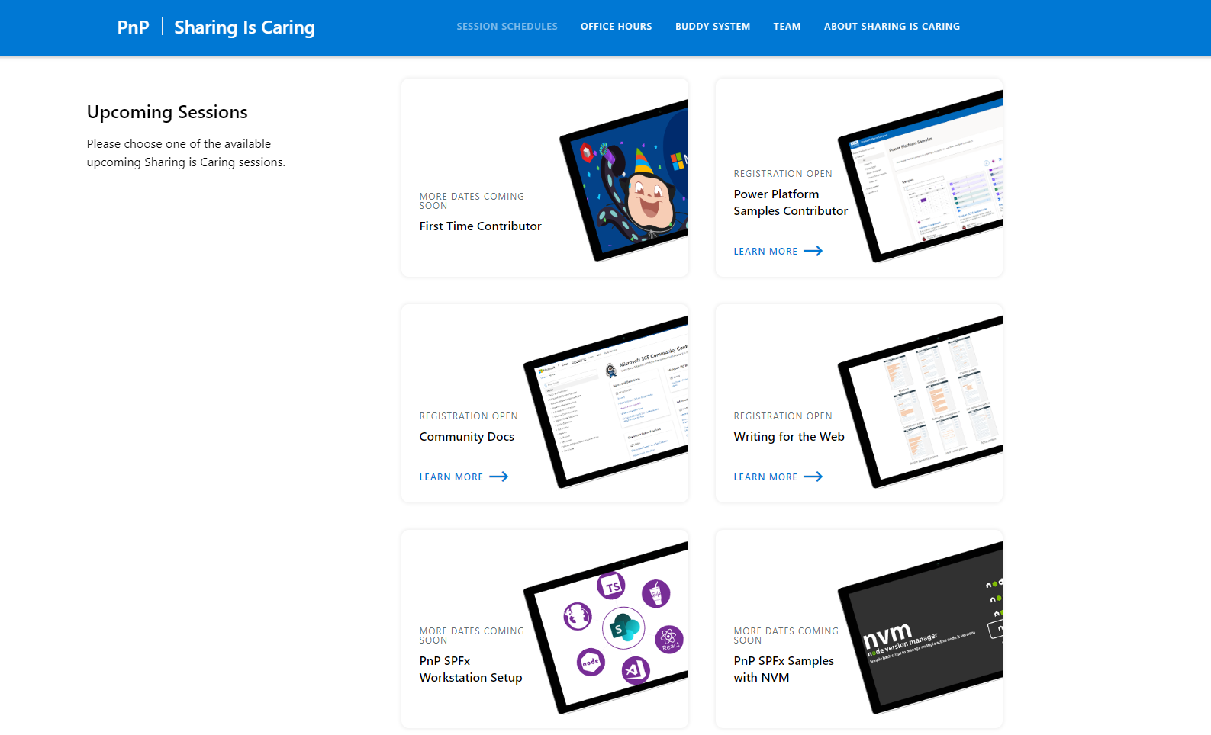
GUIDANCE
Learn how to get started in the open-source PnP community!
Upcoming Sessions:
General First Time Contributor
Power Platform Samples Contributor
Writing for the Web
SPFx Developer Workstation Setup
Using PnP SPFx samples w/ NVM
More than code with VS Code
First-time presenter
M365 Maturity Model Practitioners
Power Platform - Power Pages – Coming Soon!!!
https://aka.ms/sharing-is-caring
Notes:
25 Total attendees, 16 attendees who attended both First-Time Contributors and Community Docs sessions.

Slide 9
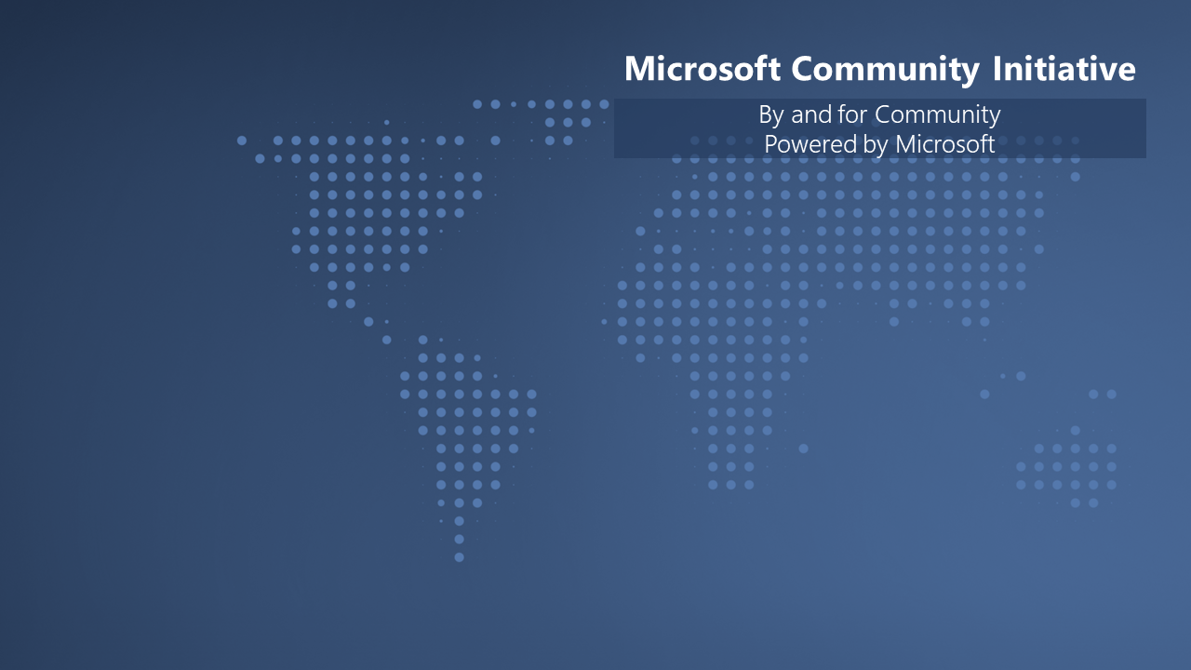

We are building a unified Microsoft Cloud Community model with Microsoft 365 and Azure. We are looking for community members to join the Community Advisory Board.
Submit at https://aka.ms/MCABLeaderApp

Slide 10



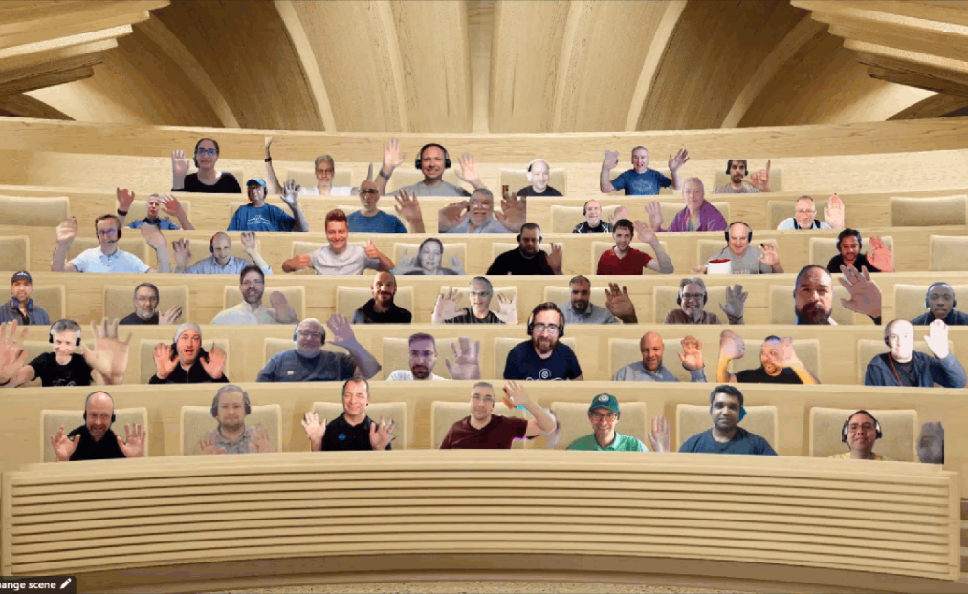






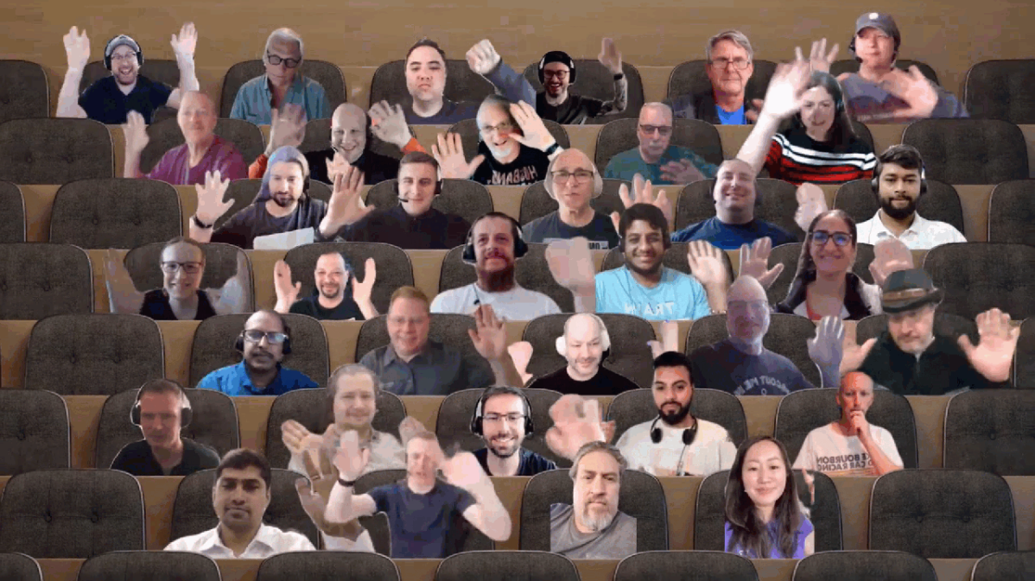







UPDATE
Microsoft 365 Platform Community (PnP) – June 2022 update is available! Thank you for your contributions!
http://aka.ms/m365/community/blog

Slide 11

Thank you for your assistance within last month! (A-I)
Abdul Mughni Ansari (Hexaware) | @Ansarimughni
Abdur Raheem (Avanade) | @im_offline
Adam Wójcik (Hitachi Energy) | @Adam2585878
Ahmad | @ahmadpirani
Ahmed (Diyar United Company) | ahghaith
Aiden Kasakya Muganzi | muganzix
Aja ifeanyi | @Ajaifeanyi
Ajo Suresh | ajo3403
Albert-Jan Schot (BLIS Digital) | @Appieschot
Alexander Ernon (Amplexor)
Aleksandr Sapozhkov | shurick81
André Lage (Datalynx AG) | @aaclage
Andreas Omayrat | andreasomayrat
Andrew Burns (AmSty) | @SharePointRox
Andrew Connell (Voitanos) | @Andrewconnell
Annie Torres (Coppin State University)
Anoop Tatti (Content+Cloud) | @Anooptells
Arjun Menon (Tata Consulting Services) | @Arjunumenon
Arleta Wanat | PowershellScripts
Art Pagano (University of Texas San Antonio)
Arun Kumar Perumal | arunkumarperumal
Beau Cameron (Aerie Consulting) | @Beau__Cameron
Bhushan Mittal (UBS) | mit579
Bianca W | bianca-git
Bob Morris (ThreeWill)
Chandani Prajapati (Rapid Circle) | @Chandani_SPD
Chris Kent (DMI) | @TheChrisKent
Chris Sparrow (PA Consulting)
Chris S | chrisms86
Christian Zuellig (MondayCoffee) | czullu
Christophe Humbert | @Path2SharePoint
Cynthia Tiwana (city of sammamish) | ctiwana
Daisy Feller
Daniel Laskewitz (Sogeti) | @Laskewitz
Daniel Pastoor | danielpastoor
Darren Brown (Node4)
David Gray (Visa)
Dennis Kuhn | DennisKuhn
Derek Cash Peterson (Sympraxis Consulting) | @Spdcp
Dennis van Niel | dennisvanniel
Dipen Shah (Rapid Circle) | @Dips_365
Django Lohn (InSpark) | @LohnDjango
Don Kirkham (DMI, Inc) | @DonKirkham
Edmund David (Insentra)
Ejaz Hussain (Content and Cloud) | @EjazHussain"
Elio Struyf (Struyf Consulting) | @Eliostruyf
Emily Mancini (Sympraxis Consulting) | @EEMancini
Eric Overfield (PixelMill) | @EricOverfield
Erwin van Hunen (Valo Intranet) | @Erwinvanhunen
Fabio Franzini (Apvee) | franzinifabio
Faride Ilanda (Atos) | @FarideIlanda
Favour Adekunle
Florian Zink | fzbm
Franck Cornu | @FranckCornu
Gerard Simpson | @powerfanaddict
Gautam Sheth (Valo Solutions) | @Gautamdsheth
Geetha Sivasailam (Artis Consulting) | @GSiVed
Giacomo Pozzoni (Fellowmind) | jackpoz
Haritha Sama (Intouch Solutions)
Harsh S (SRK Consulting)
Heidi Jordan (High Plains Technology) | @heidi_jordan14
Inez Jacobs (Amplexor)
Isolde Kanikani (SoftwareONE)
Notes:
SHARING KNOWLEDGE IS MULTIPLYING KNOWLEDGE

Slide 12
Thank you for your assistance within last month! (J-R)
Jay Jani
Jake Stanger | JakeStanger
James May | fowl2
Jan Vidar Elven (Skill AS) | @JanVidarElven
Jasey Waegebaert (GMI Group) | Jwaegebaert
Jennifer Davison (Akron Children's Hospital)
Jennifer McGee | RainWatcher
Jim Duncan (ShareSquared) | @Sparchitect
Jimmy Hang
João Ferreira | @Joaoferreira
João J. Mendes (Valo Solutions) | @Joaojmendes
Joel Rodrigues (Storm Technology) | @JoelFMRodrigues
Jonathan Hinchliffe (Imperial War Museums)
Jordan Spooner | jordanspooner
Julie Turner (Sympraxis Consulting) | @Jfj1997
Katrin Rannaste
Krishna Rachakonda (Catapult) | rsk2013
Laura Kokkarinen (Sulava) | @LauraKokkarinen
Leon Armston (Intelogy) | @LeonArmston
Luise Freese (M365Princess) | @LuiseFreese
Luis Mañez () | @luismanez
Maarten van Stam | @aafvstam
Manickam Sethuramalingam (microland)
Marc D Anderson (Sympraxis Consulting) | @Sympmarc
Marcin Wojciechowski (Valo) | @mgwojciech
Markus Möller (Avanade) | @Moeller2_0
Martin Lingstuyl | @Martinlingstuy
Mathijs Verbeeck | MathijsVerbeeck
Matthew Jones (The Church of Jesus Christ of Latter-day Saints) | msterlingjones
Mai Mostafa | Maya-Mostafa
Michael Badia | stoicvincero
Michaël Maillot ( OnePoint) | @michael_maillot
Michael Roth ( ITP) | @MichaelRoth42
Michelle Heisler (Hennepin County)
Miguel Angel García | @Miangama
Milan Holemans | milanholemans
Mitanshu Garg
Nanddeep Nachan | @nanddeepNachan
Nicole Fleming (Sherwin Williams)
Ole Kristian Mørch-Storstein
Paolo Pialorsi (PiaSys.com) | @PaoloPia
Patrick Lamber (ExpertsInside AG) | @Patricklamber
Patrik Hellgren (Sherpas Group) | @Patrikhellgren
Paul Bullock (Avanade) | @Pkbullock
Paul Schaeflein (AddIn365) | @Paulschaeflein
Rachel Irabor | @Richie4love
Ravichandran Krishnasamy (Content Formula) | @Spfx_blog
Rene Modery (WPP) | @modery
Reshmee Auckloo (Pension Protection Fund) | @ReshmeeAuckloo
Rico van de Ven | RicoNL
Rick Van Rousselt (Advantive) | @RickVanRousselt
Rob Bell (Kizan technologies)
Rob Ellis | ee61re
Rob Windsor | @robwindsor
Robert Lindström | robert-lindstrom
Rodrigo Pinto (Storm Technology) | @ScoutmanPt
Rohit S Patil (C3it)
Notes:
SHARING KNOWLEDGE IS MULTIPLYING KNOWLEDGE

Slide 13
Thank you for your assistance within last month! (S-Y)
Sabrina Faragoza (Cognizant's Microsoft Business Group)
Saisang Cai
Sami Nieminen | stniemin
Sergei Sergeev | @Sergeev_srg
Shrushti Shah (Rapid Circle)
Sid Lama
Siddharth Vaghasia | @Siddh_me
Simon Doy (iThink 365) | @Simondoy
Simon Hudson (Novia Works) | @Simonjhudson
Smita Nachan | @SmitaNachan
Sohil Bhalla | sohilbhalla
Sorina Becheru (abtis GmbH)
Stefan Bauer (n8d) | @StfBauer
Stephan Bisser (Solvion) | @Stephanbisser
Stephen Peters | StephenBrentPeters
Sudharsan Kesavanarayanan | sudharsank
Tammy Dupuy (CSULB)
Tetsuya Kawahara | @Techan_k
Thomas Gölles (Solvion) | @Thomyg
Tod Beane
Todd Alexander (Island Way Technology)
Todd Baginski (Canviz) | @Toddbaginski
Tom Morgan (Modality Systems) | @tomorgan
Tomasz Poszytek | @TomaszPoszytek
Troy Tanon | troytanon
Troy Taylor (Hitachi Solutions) | @Troystaylor
Udeagha Kingsley (Sterling Bank) | @kylzbaba
Veronique Lengelle (CPS) | @Veronicageek
Yannick Plenevaux (PVX Solutions) | @Yp_code
Yungfu | Yungfu
Youssef Moumen
Notes:
SHARING KNOWLEDGE IS MULTIPLYING KNOWLEDGE

Slide 14




























Companies involved with June 2022 summary
Companies which provided support for community
We can only show the company logos which we have explicitly approval for logo usage
You contributed and your company is not here? – Send us a message with your permissions and logo
Notes:
SHARING KNOWLEDGE IS MULTIPLYING KNOWLEDGE

Slide 15

Thank you for your assistance! – Microsoft
Alex Clark (Microsoft) | @Sharepointalex
Alex Terentiev (Microsoft) | @Alexaterentiev
Altamish Ahmad (Microsoft)
Amber Weise (Microsoft)
Andrey Esipov (Microsoft)
Anuj Gupta (Microsoft)
April Dunnam (Microsoft) | @Aprildunnam
Arvind Ravi (Microsoft)
Ayca Bas (Microsoft) | @Aycabs
Ben Summers (Microsoft)
Bert Jansen (Microsoft) | @O365Bert
Bob German (Microsoft) | @Bob1German
Brian Dang (Microsoft) | @Mrdang
Brian Jackett (Microsoft) | BrianTJackett
Bryan Petersen (Microsoft) | bpeterse03
Camille Birch (Microsoft)
Cathy Dew (Microsoft) | @Catpaint
Christer Ljung (Microsoft)
Dan Wahlin (Microsoft) | @DanWahlin
David Chesnut (Microsoft) | @Davidchesnut
David Rousset (Microsoft) | @davrous
David Warner II (Microsoft) | @DavidWarnerII
Didun Ayodeji (Microsoft)
Doğan Erişen (Microsoft) | derisen
Dragan Panjkov (Microsoft) | @Panjkov
Ed Averett (Microsoft) | Ed_Everett
Eoin O'Brien
Elizabeth Samuel (Microsoft)
Erin Bailie (Microsoft) | @EMBailie
Garry Trinder (Microsoft) | @Garrytrinder
Holger Lutz (Microsoft) | HolgerLutz
Hugo Bernier (Microsoft) | @Bernierh
James Eccles (Microsoft) | @jimdeccles
James Lau (Microsoft)
James Skay (Microsoft) | @JamesSka
Jasmine Hoegh (Microsoft) | @Sbjishu
Jeff Teper (Microsoft) | @JeffTeper
Joanne Hendrickson (Microsoft) | JoanneHendrickson
John Nguyen (Microsoft) | johnguy0
John Sudds (Microsoft) | @Jsuddsjr
Jos Verlinde (Microsoft) Josverl
Jyoti Pal (Microsoft)
Kevin Coughlin (Microsoft) | @Kevintcoughlin
Koen Zomers (Microsoft) | @Koenzomers
Laura Graham (Microsoft) | Lauragra
Holland Kaviani (Microsoft)
Linda Lu Cannon - (Microsoft) | lindalu-MSFT
Loki Meyburg (Microsoft) (Microsoft) | @Lokimeyburg
Luca Bandinelli (Microsoft) | lucaband
Luca Spolidoro (Microsoft) |@Licantrop0
Michael Aldridge (Microsoft)
Mikael Svenson (Microsoft) | @Mikaelsvenson
Mike Hollinshead (Microsoft) | @Mahollinshea
Mounika Narayanan (Microsoft) | @nmounika97
Nancy Wang (Microsoft) | @nancyatMSFT
Natalie Pienkowska (Microsoft) | @nataliePienkow1
Nathan Zipf (Microsoft) | NathZ1
Nick Kramer (Microsoft)
Nik Charlebois (Microsoft) | @nikCharlebois
Nicolas Vogt (Microsoft) | vogtn
Nickii Miaro (Microsoft) | Nickii Miaro
Niko (Microsoft) | NikoMix
Nikola Metulev (Microsoft) | @Metulev
Pam Green (Microsoft) | @Contextuallib
Pat Miller (Microsoft) | @PatMill_MSFT
Patrick Rodgers (Microsoft) | @Mediocrebowler
Rabeb Othmani (Microsoft) | @Rabeb_Othmani
Rabia Williams (Microsoft) | @Williamsrabia
Rick Kirkham (Microsoft)
Roy Paar (Microsoft) | @RoyPaar
Rui Santos (Microsoft)
Sam Larson (Microsoft) | salarson
Saurabh Bhatia (Microsoft) | @iamSBTron
Shane Weaver (Microsoft) | shweaver-MSFT
Shreyansh Agrawal (Microsoft) | shagra-ms
Sean Squires (Microsoft) | @iamseansquires
Sébastien Levert (Microsoft) | @Sebastienlevert
Shreya Ganguly (Microsoft)
Shubham Gatkal (Microsoft)
Srinivas Varukala (Microsoft) | @Svarukala
Steven Jia (Microsoft) | Steven-Jia
Stephen Rose (Microsoft) | @stephenlrose
Swapnil Shrivastava (Microsoft)
Tejas Mehta (Microsoft) | @Tpmehta
Tim Mayo (Microsoft) | @Timmayo
Tom Resing (Microsoft) | @Resing
Tomomi Imura (Microsoft) | @Girlie_mac
Vesa Juvonen (Microsoft) | @Vesajuvonen
Wajeed Shaikh | Wajeed-msft
Waldek Mastykarz (Microsoft) | @Waldekm
Wictor Wilen(Microsoft) | @Wictor
Vincent Biret (Microsoft) | @baywet
Notes:
SHARING KNOWLEDGE IS MULTIPLYING KNOWLEDGE

Slide 16

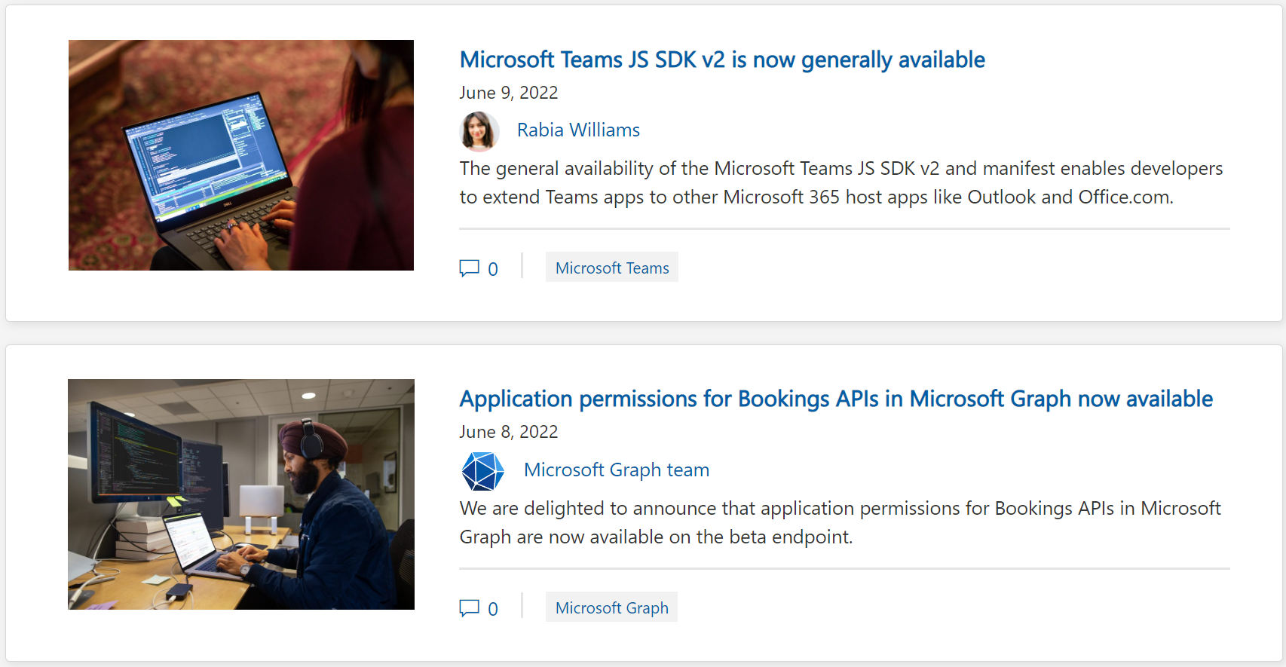
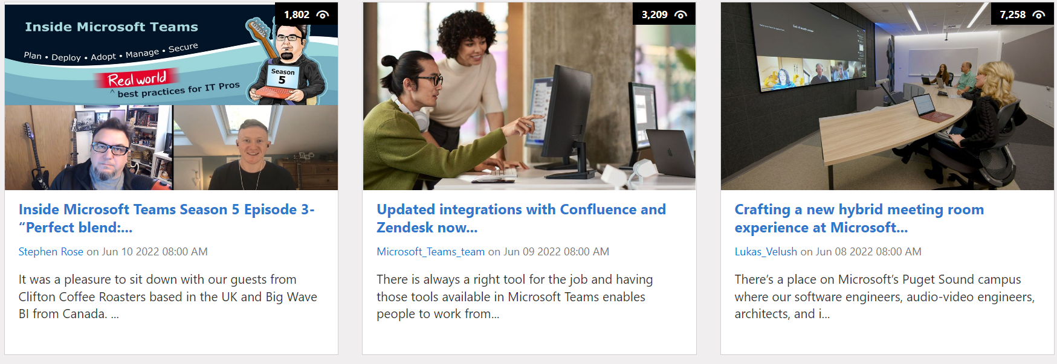
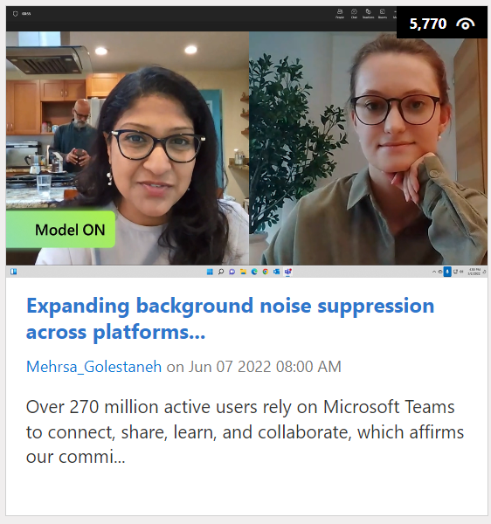
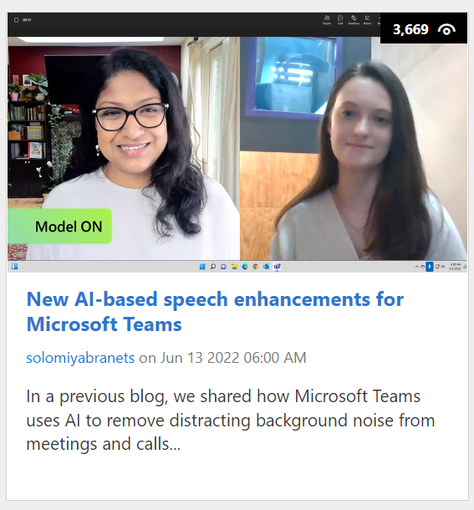
https://aka.ms/m365dev/blog
https://aka.ms/teams/blog
https://aka.ms/microsoftviva/blog

Slide 17
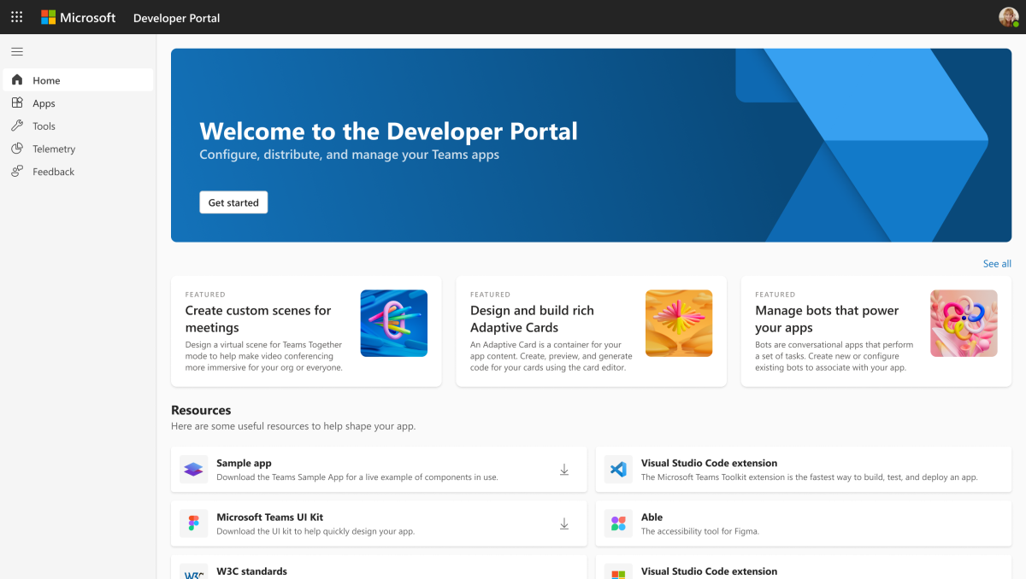
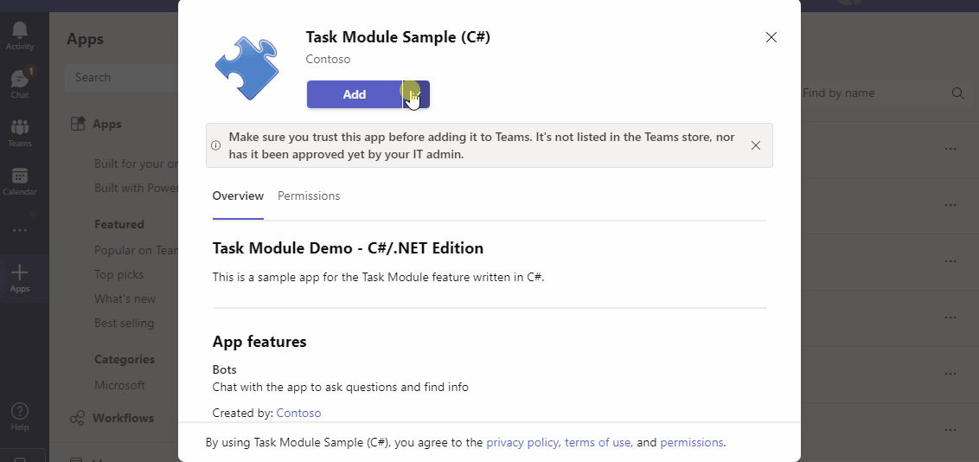






Teams Platform updates Feature update
1
Send welcome messages to user selected channel (Developer Preview)
2
App Studio will be deprecated by June 30, 2022.
Use Developer Portal: https://dev.teams.microsoft.com/
Docs: http://aka.ms/TeamsDevDocs > Tools and SDKs > Developer Portal for Teams
Docs: http://aka.ms/TeamsDevDocs > Build Bots > Conversation events in your Teams bot
@Microsoft365Dev
aka.ms/TeamsPlatformUpdates
aka.ms/TeamsDevDocs
aka.ms/TeamsSamples
aka.ms/TeamsPlatformFeedback
Notes:
Wajeed covering 6/14/2022 Hello everyone. I’d walk you through the Teams platform updates. Let’s start with the platform update on the left side.
Sending welcome message to user selected channel.
Welcome messages from your conversational app are the first thing users see after installation. They play a core part in highlighting your app’s main features, starting the setup flow and onboarding users, and improving activation down the line. We have updated installationUpdate & conversationUpdate events to help streamline the user installation flow and welcome messages sent by apps.
Before this feature, apps’ welcome message was always sent to the ‘General’ channel and not to the user selected one. With this update, welcome messages will be automatically routed to the user selected channel post installation.
when an app is installed in a team’s context from the client, the user selected channel id from the installation flow will be sent to the bot set as the conversation.id for installationUpdate and conversationUpdate event.
No changes are required for bots that currently send welcome messages by replying to either the installationUpdate or conversationUpdate events using the conversation.id. This should be the case for most apps. Bots that are not using the provided conversation.id to send welcome messages in teams can be updated to reply using this value to take advantage of this change.
2. Second update is on App Studio deprecation, it will be deprecated by 30 June. Now you can Configure, distribute, and manage your Teams apps with the new Developer Portal. Your existing apps will be available in Developer Portal under Apps/ App Studio. You can upgrade these apps to the latest configuration so that you can start using them in Developer Portal.
So, these were the platform updates, if you have any feedback or suggestion, please post on aka.ms/TeamsPlatformFeedback- the link is available in the footer. You could also follow us on twitter and configure to the RSS feeds to get regular platform updates.

Slide 18
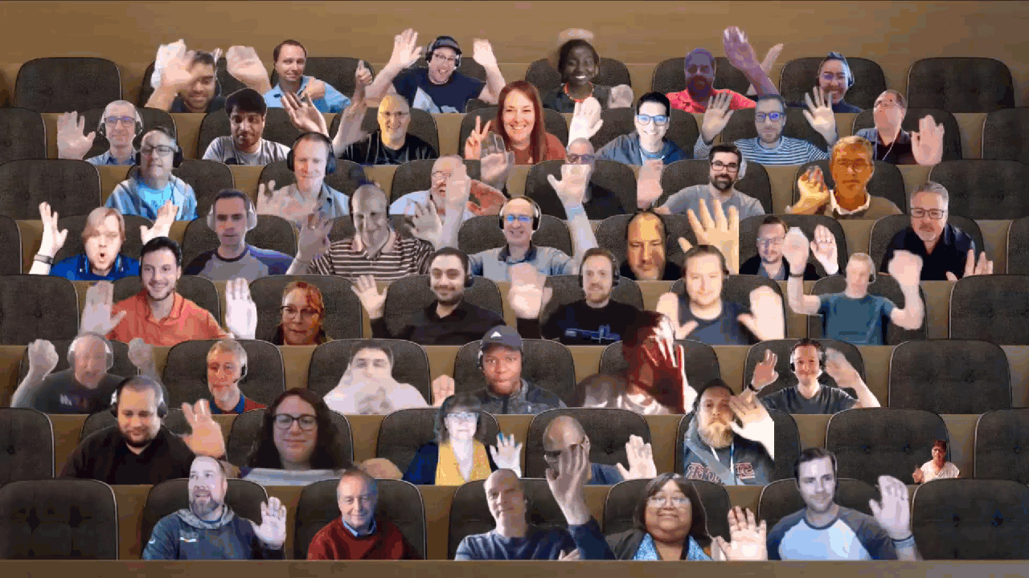

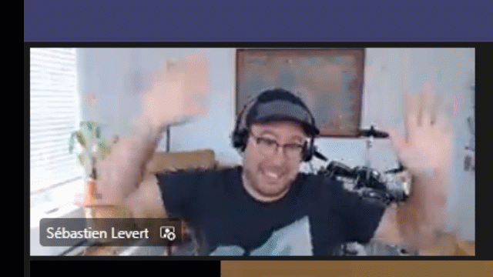
Optional picture time!
Video on and we’ll grab a Together Mode pic with those who are willing to do this.
We are together on this as a community!
Let’s all be like Seb
By enabling your camera for the picture, you grant us permission to share your picture in social media.

Slide 19

DEMO
Latest on deprecating basic auth for Exchange - Greg Taylor
Microsoft Graph .Net SDK v5 - Andrew Omondi
Introduction to Microsoft Graph Postman collection - Sébastien Levert

Slide 20
Thank you
Recording will be available in 24 hours on
Microsoft 365 Community (PnP) YouTube channel
https://aka.ms/M365PnP/videos
(subscribe today)
Follow us on Twitter
@Microsoft365Dev | @M365PnP
Next Microsoft 365 Platform call: June 21st at 08:00 am PT
All available community calls from https://aka.ms/m365/calls
(Notice. This call is on a summer break between July 1st and 31st of August 2022)

Slide 21



aka.ms/m365pnp

